Slide 1
Digital Portfolio
STUDENT NAME : M. SREEMATHI
REGISTER NO AND NMID: autanm20124132011802522100
DEPARTMENT : Bsc. Computer science
COLLEGE : Arignar Anna government arts college
UNIVERSITY : Annamalai University

Slide 2
PROJECT TITLE
MY DIGITAL PORTFOLIO

Slide 3


AGENDA
Problem Statement
Project Overview
End Users
Tools and Technologies
Portfolio design and Layout
Features and Functionality
Results and Screenshots
Conclusion
Github Link
3/21/2024 Annual Review

Slide 4

PROBLEM STATEMENT
STUDENTS NEED A SIMPLE WAY TO SHOWCASE THEIR SKILLS AND
PROJECTS ONLINE

Slide 5

PROJECT OVERVIEW
THE PROJECT AIMS TO CREATE A SIMPLE,RESPONSIVE AND INTERACTIVE DIGITAL RESUME USING HTML,CSS AND JAVASCRIPT.

Slide 6

WHO ARE THE END USERS?
EMPLOYERS , RECRUITERS

Slide 7

TOOLS AND TECHNIQUES
TOOLS:
HTML5 – For creating the structure of the resume (headings, lists, sections
CSS3 – For styling (colors, layout, spacing, responsiveness
JavaScript – For interactivity (button click greeting message
TECHNIQUES:
Responsive Web Design – Used percentage widths and max-width for mobile & desktop view.2. CSS Styling Techniques – Box shadows, border-radius, hover effects, padding & margin for neat UI.

Slide 8
POTFOLIO DESIGN AND LAYOUT
DESIGN :
Simple & Professional → Clean background, readable fonts, neat spacing.User-Friendly → Easy navigation (scrolling design).Responsive → Works on both desktop and mobile screens.Attractive UI → Use of colors, rounded corners, shadows, and hover effects
Layout Structure :
Candidate’s Name (Large heading, bold).Contact Information Email, Phone, IconsA short introduction about yourself.Simple paragraph describing skills and career goals.
8

Slide 9
FEATURES AND FUNCTIONALITY
Features
Personal Information SectionDisplays your name, email, and phone number at the to.
About Me SectionA short bio describing your career goals and passion.
Functionality
Static Content DisplayAll resume sections are displayed clearly in a structured format.
2. Button InteractivityJavaScript updates the webpage dynamically
(innerText) when the button is clicked.

Slide 10
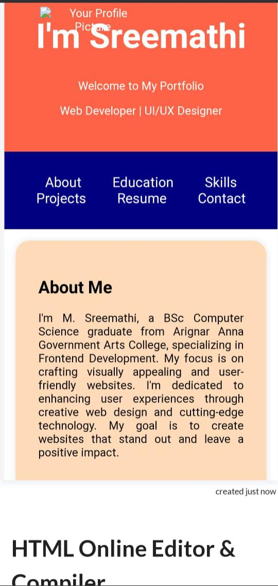
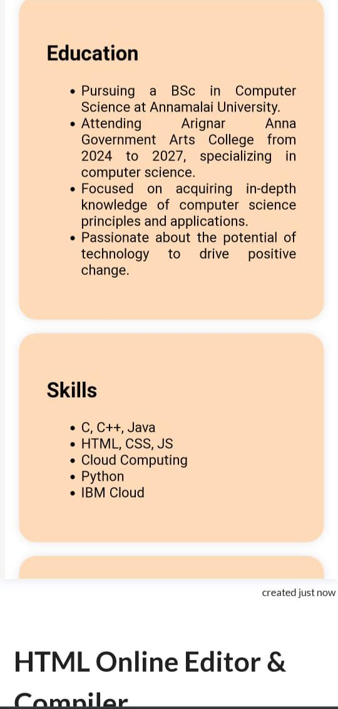
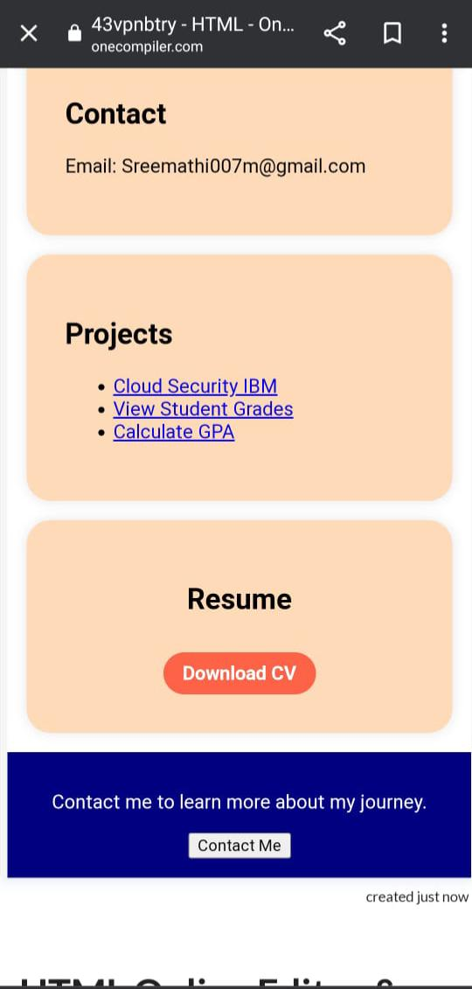

RESULTS AND SCREENSHOTS
created usiA fully functional digital resume webpage was successfully ng HTML, CSS, and JavaScript
2. The layout is clean, professional, and user-friendly, making it easy for recruiters and employers to read and understand the candidate’s profile.
3. The About Me, Education, Skills, and Experience sections clearly highlight important information in a structured manner.
4. The interactive greeting button enhances user engagement and demonstrates basic JavaScript functionality.
5. The design is responsive, ensuring the resume displays properly on desktops, tablets, and mobile devices.
3/21/2024 Annual Review
10

Slide 11
CONCLUSION
THE DIGITAL PORTFOLIO PROJECT WAS SUCCESSFULLY DEVELOPED USING HTML,CSS AND JAVASCRIPT
11

